Slide 1

Drools and jBPM 7.x
Parameswari Ettiappan

Slide 2
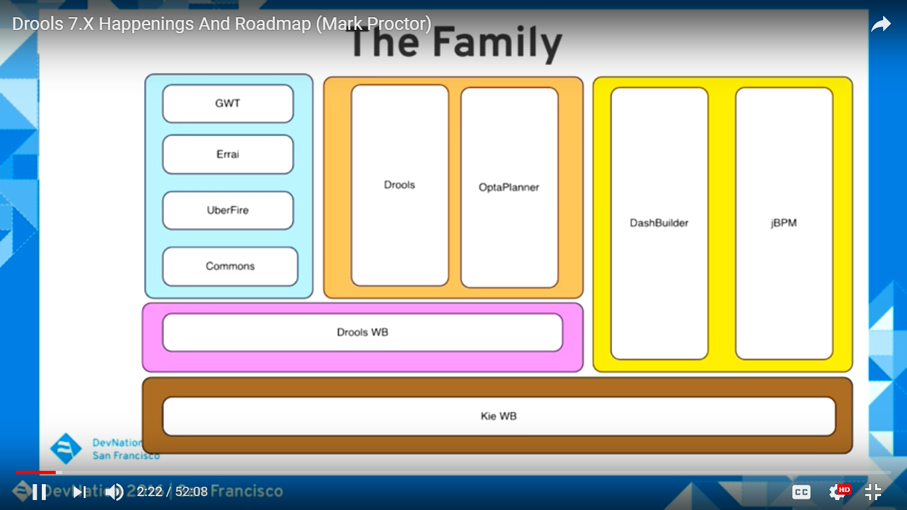

Slide 3
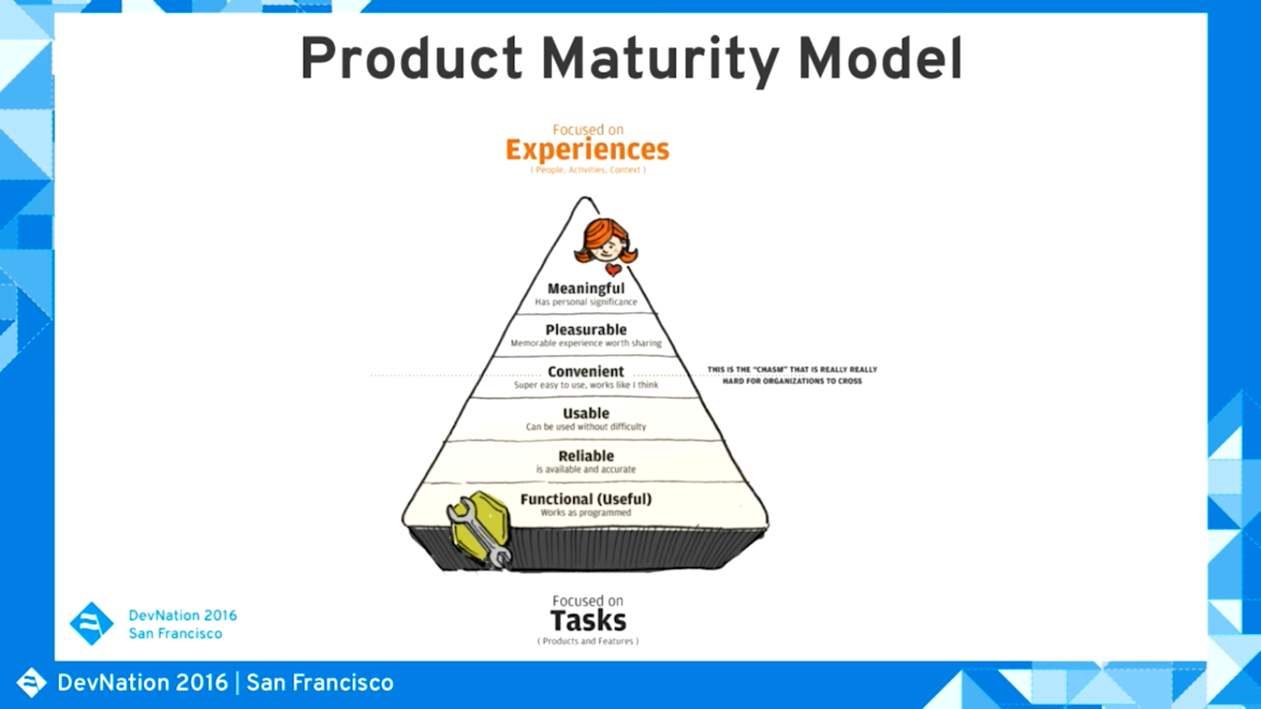

Slide 4
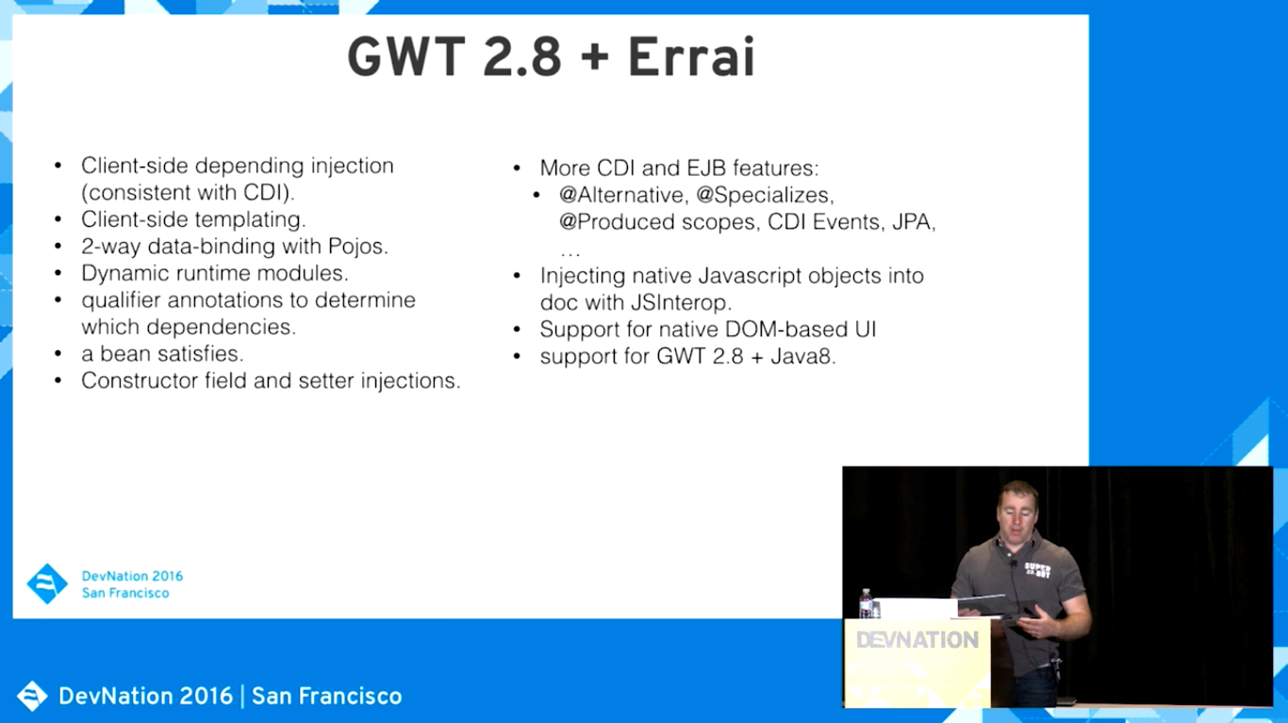

Slide 5
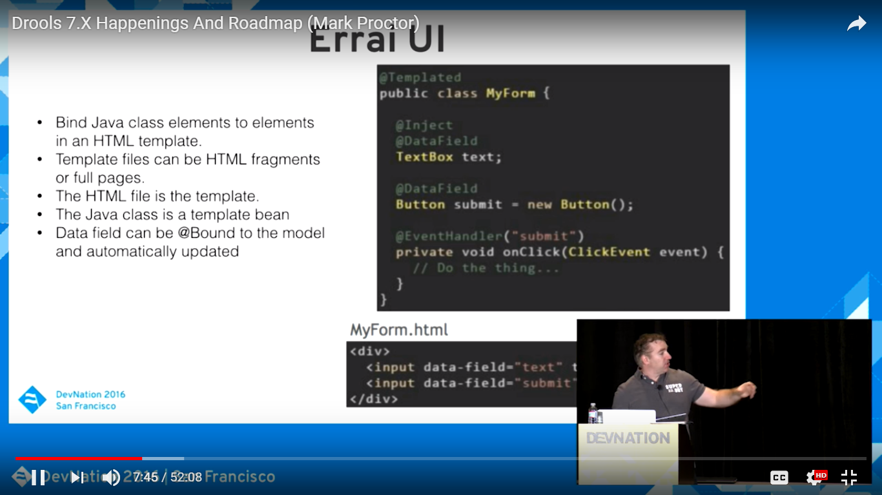

Slide 6
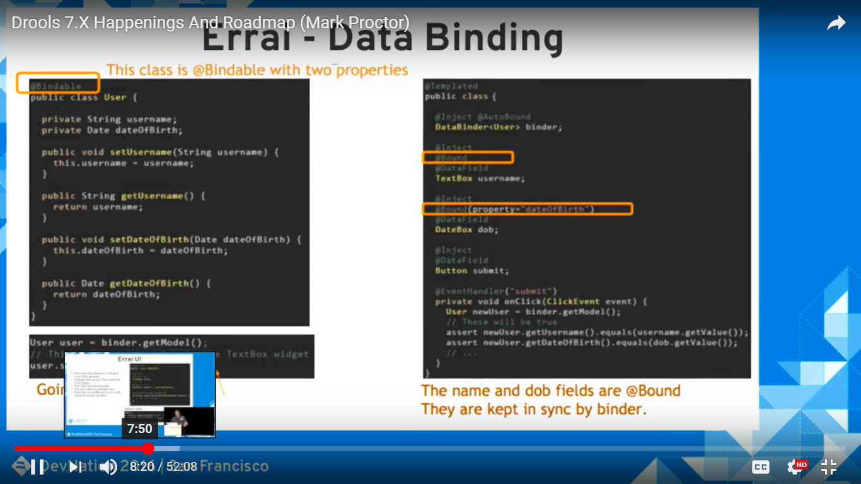

Slide 7
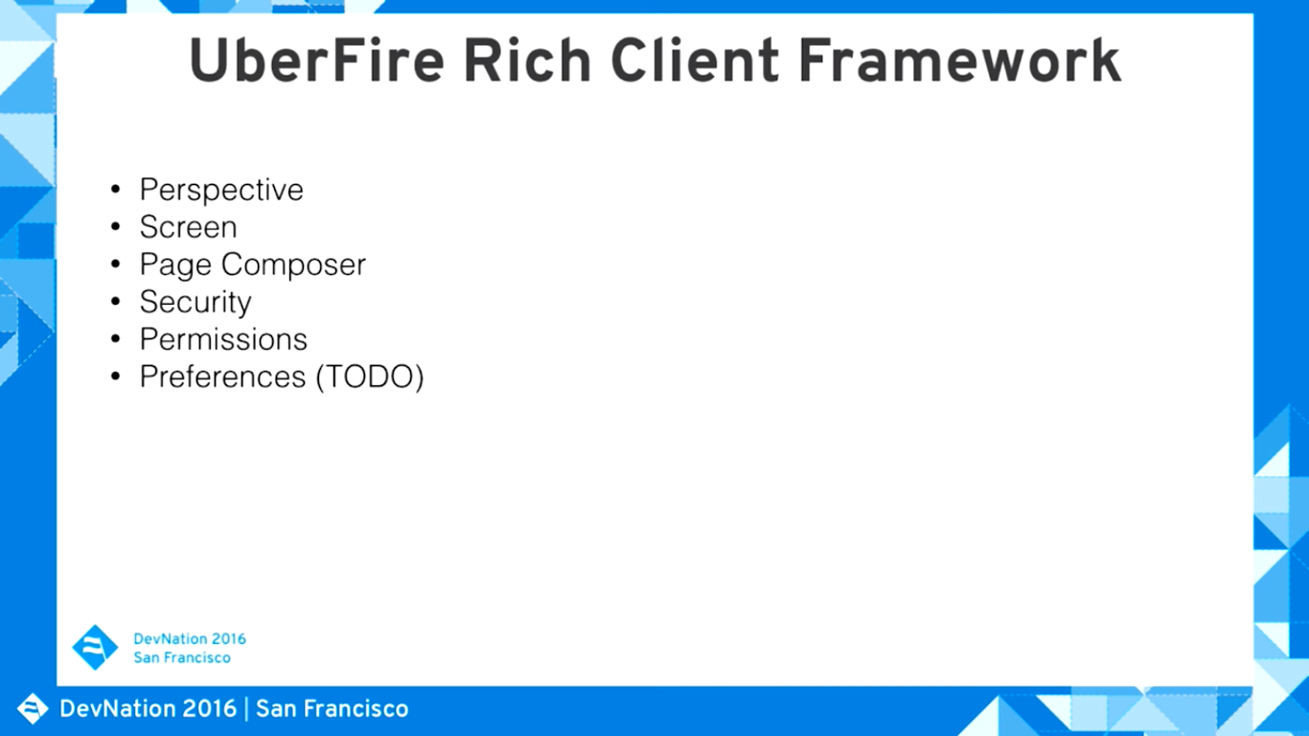

Slide 8
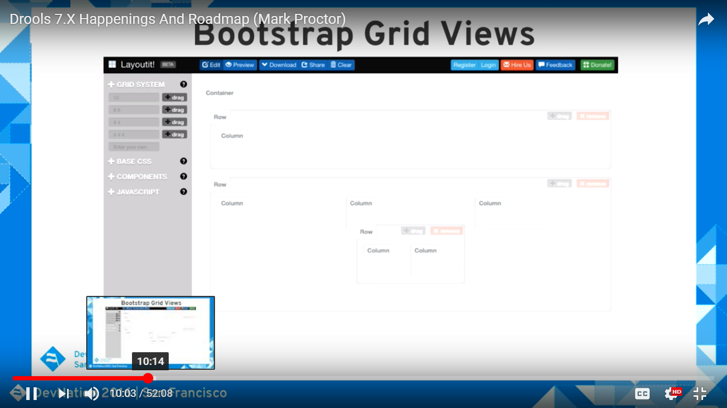

Slide 9
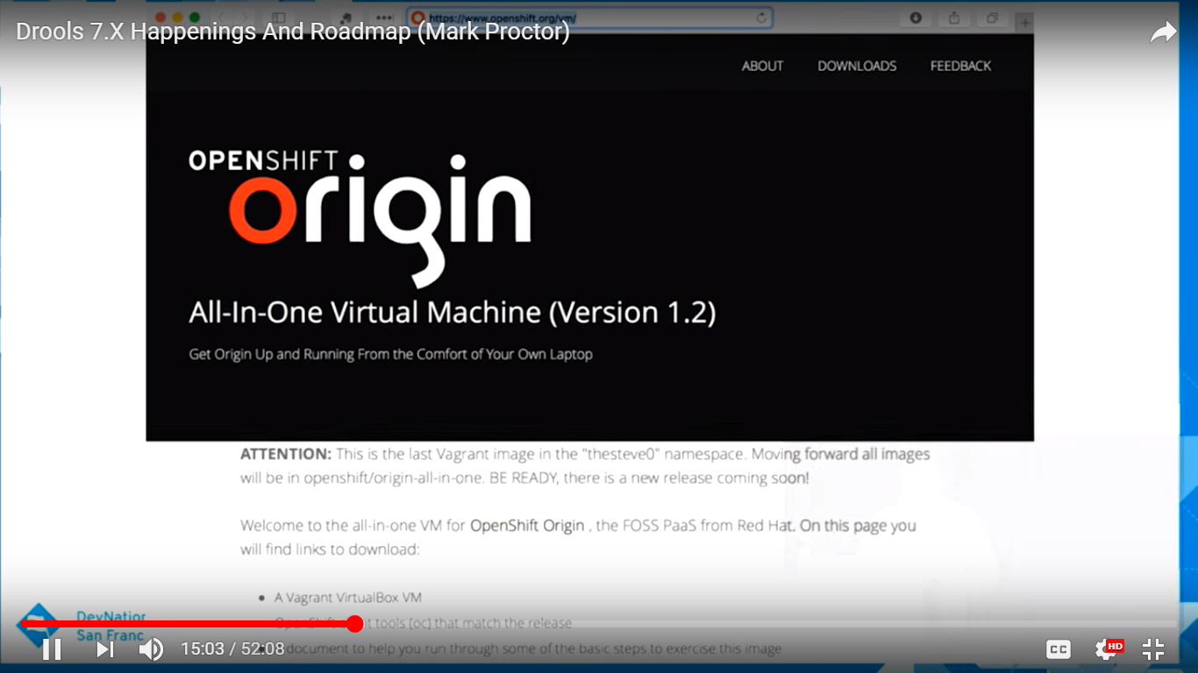

Slide 10
What is a Rule Engine?
Knowledge representation is the area of A.I. concerned with how knowledge is represented and manipulated.
Expert Systems use Knowledge representation to facilitate the codification of knowledge into a knowledge base which can be used for reasoning

Slide 11
What is a Rule Engine?
The process of developing with an Expert System is Knowledge Engineering.
EMYCIN was one of the first "shells" for an Expert System, which was created from the MYCIN medical diagnosis Expert System.

Slide 12
What is a Rule Engine?
The process of developing with an Expert System is Knowledge Engineering.
Early Expert Systems had their logic hard-coded.

Slide 13
Drools
Drools is a Rule Engine that uses the rule-based approach to implement an Expert System.
It is more correctly classified as a Production Rule System.
The term "Production Rule“ --- "an abstract structure that describes a formal language precisely,
Its is a set of rules that mathematically delineates a set of finite-length strings over a (usually finite) alphabet

Slide 14
BRMS
Business Rule Management Systems build additional value on top of a general purpose Rule Engine by providing
business user focused systems for rule creation,
management, deployment, collaboration, analysis and end user tools.

Slide 15
How to Build a Business Rules Engine
The term Rule Engine is quite ambiguous.
It can be any system that uses rules, in any form, that can be applied to data to produce outcomes.
This includes simple systems like form validation and dynamic expression engines.

Slide 16
jBPM Rule Engine
JBoss jBPM uses expressions and delegates in its Decision nodes which control the transitions in a Workflow.
At each node it evaluates there is a rule set that dictates the transition to undertake, and so this is also a Rule Engine.

Slide 17
Production System vs Rule Engine
Production Rule System is a kind of Rule Engine and also an Expert System.
The validation and expression evaluation Rule Engines mentioned previously are not Expert Systems.
A Production Rule System is Turing complete, with a focus on knowledge representation to express propositional and first order logic in a concise, non-ambiguous and declarative manner.

Slide 18
Production System vs Rule Engine
The brain of a Production Rules System is an Inference Engine that is able to scale to a large number of rules and facts.
A Production Rule is a two-part structure using First Order Logic for reasoning over knowledge representation.
The process of matching the new or existing facts against Production Rules is called Pattern Matching, which is performed by the Inference Engine.

Slide 19
Production System vs Rule Engine
There are a number of algorithms used for Pattern Matching by Inference Engines including:
Linear
Rete
Treat
Leaps

Slide 20
Drools Production System
Drools implements and extends the Rete algorithm;
Leaps used to be provided but was retired as it became unmaintained.
The Drools Rete implementation is called ReteOO, signifying that Drools has an enhanced and optimized implementation of the Rete algorithm for object oriented systems.

Slide 21
Drools Production System
The Rules are stored in the Production Memory.
The facts that the Inference Engine matches against are kept in the Working Memory.
Facts are asserted into the Working Memory where they may then be modified or retracted.
A system with a large number of rules and facts may result in many rules being true for the same fact assertion; these rules are said to be in conflict.

Slide 22
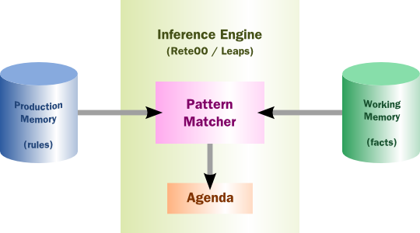
Drools Production System(High-level View of a Rule Engine)

Slide 23
Rule System Execution
There are two methods of execution for a rule system:
Forward Chaining and Backward Chaining;
Systems that implement both are called Hybrid Chaining Systems.
As of Drools 5.2 Drools provides seamless hybrid chaining, both forward and backwards.

Slide 24
Rule System Execution
Understanding these two modes of operation is the key to understanding why a Production Rule System is different and how to get the best from it.

Slide 25
Rule System Execution
Forward chaining is "data-driven" and thus reactionary, with facts being asserted into working memory, which results in one or more rules being concurrently true and scheduled for execution by the Agenda.

Slide 26
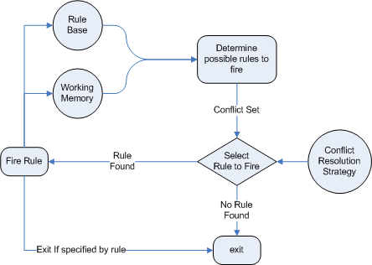
Rule System Execution

Slide 27
Rule System Execution
Backward chaining is "goal-driven", meaning that we start with a conclusion which the engine tries to satisfy.
If it can't it then searches for conclusions that it can satisfy; these are known as subgoals, that will help satisfy some unknown part of the current goal.
It continues this process until either the initial conclusion is proven or there are no more subgoals.
Prolog is an example of a Backward Chaining engine.
Drools can also do backward chaining, which we refer to as derivation queries.

Slide 28
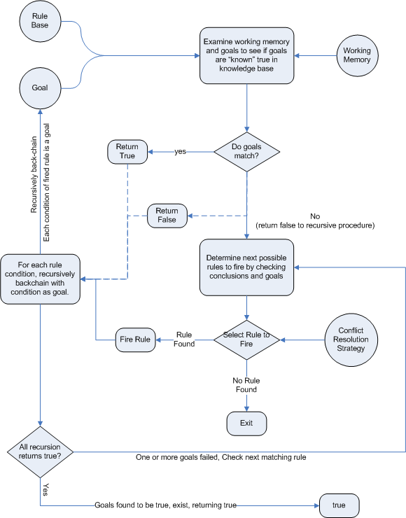

Slide 29
Advantages of a Rule Engine
Declarative Programming
Rule engines allow you to say "What to do", not "How to do it".
Rule systems are capable of solving very, very hard problems, providing an explanation of how the solution was arrived at and why each "decision" along the way was made

Slide 30
Advantages of a Rule Engine
Logic and Data Separation
Data is in your domain objects, the logic is in the rules. This is fundamentally breaking the OO coupling of data and logic.
The logic is all laid out in rules.
Instead of the logic being spread across many domain objects or controllers, it can all be organized in one or more very distinct rules files.

Slide 31
Advantages of a Rule Engine
Speed and Scalability
The Rete algorithm,the Leaps algorithm, and their descendants such as Drools' ReteOO, provide very efficient ways of matching rule patterns to your domain object data.
These are especially efficient when you have datasets that change in small portions as the rule engine can remember past matches. These algorithms are battle proven.

Slide 32
Advantages of a Rule Engine
Centralization of Knowledge
By using rules, you create a repository of knowledge (a knowledge base) which is executable.
This means it's a single point of truth, for business policy, for instance.
Ideally rules are so readable that they can also serve as documentation.

Slide 33
Advantages of a Rule Engine
Tool Integration
Tools such as Eclipse (and in future, Web based user interfaces) provide ways to edit and manage rules and get immediate feedback, validation and content assistance.
Auditing and debugging tools are also available.

Slide 34
Advantages of a Rule Engine
Explanation Facility
Rule systems effectively provide an "explanation facility" by being able to log the decisions made by the rule engine along with why the decisions were made.
Understandable Rules
By creating object models and, optionally, Domain Specific Languages that model your problem domain you can set yourself up to write rules that are very close to natural language.

Slide 35
When to use Rule Engine
The shortest answer to this is "when there is no satisfactory traditional programming approach to solve the problem.".

Slide 36
Difference between Stateless and Stateful Session -
The major differences are-
Stateless Session | Stateful Session
Any changes in the facts while executing rules is not made aware to the rule engine. | Any changes in the facts while executing rules is made aware to the rule engine.
dispose() method is called automatically to release the session. | dispose() method should be called to release the session to avoid memory leaks.
The engine is caused to “fire” via a call to one of the execute() methods. The two variants are; 1) pass a single object/fact, or 2) pass an iterable object that contains the fact(s) that will be used. | Provide a variety of methods to cause the engine to “fire” (i.e. execute the consequences of rules scheduled for activation). fireAllRules() fireAllRules(AgendaFilter filter) fireAllRules(AgendaFilter filter, int max) fireAllRules(int max) fireUntilHalt() fireUntilHalt(AgendaFilter filter)
Any changes in the facts while executing rules is not made aware to the rule engine so if any rule is modified no other re-activation of rules will take place. | As any changes in facts is available to the rule engine so if a rule is modified for a particular fact, this change will re-activate all the rules and fire the rules that are build on modified fact.

Slide 37
Stateless Knowledge Session
Stateless session, not utilising inference, forms the simplest use case.
A stateless session can be called like a function passing it some data and then receiving some results back.
Validation
Is this person eligible for a mortgage?
Calculation
Compute a mortgage premium.
Routing and Filtering
Filter incoming messages, such as emails, into folders.
Send incoming messages to a destination.

Slide 38
Stateless Knowledge Session
public class Applicant { private String name; private int age; private boolean valid; // getter and setter methods here }
package com.company.license
rule "Is of valid age"
when
$a : Applicant( age < 18 )
then
$a.setValid( false );
end

Slide 39
Knowledge Base and Knowledge Builder
Let's assume that the rules are in the same folder as the classes, so we can use the classpath resource loader to build our first KnowledgeBase.
A Knowledge Base is what we call our collection of compiled definitions, such as rules and processes, which are compiled using the KnowledgeBuilder.
Both the KnowledgeBuilder and KnowledgeBase can be created from the factories KnowledeBuilderFactory and KnowledgeBaseFactory.

Slide 40
Knowledge Base and Knowledge Builder
KnowledgeBuilder kbuilder = KnowledgeBuilderFactory.newKnowledgeBuilder();
kbuilder.add( ResourceFactory.newClassPathResource( "licenseApplication.drl", getClass() ),
ResourceType.DRL );
if ( kbuilder.hasErrors() ) {
System.err.println( kbuilder.getErrors().toString() );
}
KnowledgeBase kbase = KnowledgeBaseFactory.newKnowledgeBase();
kbase.addKnowledgePackages( kbuilder.getKnowledgePackages() );

Slide 41
Stateless Knowledge Session
StatelessKnowledgeSession ksession = kbase.newStatelessKnowledgeSession();
Applicant applicant = new Applicant( "Mr John Smith", 16 );
assertTrue( applicant.isValid() );
ksession.execute( applicant );
assertFalse( applicant.isValid() );

Slide 42
Stateless Knowledge Session
public class Applicant {
private String name;
private int age;
// getter and setter methods here
}
public class Application {
private Date dateApplied;
private boolean valid;
// getter and setter methods here
}

Slide 43
Stateless Knowledge Session
package com.company.license
rule "Is of valid age"
when
Applicant( age < 18 )
$a : Application()
then
$a.setValid( false );
end
rule "Application was made this year"
when
$a : Application( dateApplied > "01-jan-2009" )
then
$a.setValid( false );
end

Slide 44
Stateless Knowledge Session
StatelessKnowledgeSession ksession = kbase.newStatelessKnowledgeSession();
Applicant applicant = new Applicant( "Mr John Smith", 16 );
Application application = new Application();
assertTrue( application() );
ksession.execute( Arrays.asList( new Object[] { application, applicant } ) );
assertFalse( application() );

Slide 45
Stateful Knowledge Session
Stateful Sessions are longer lived and allow iterative changes over time.
Stateful Sessions are, but not limited to:
Monitoring
Stock market monitoring and analysis for semi-automatic buying.
Diagnostics
Fault finding, medical diagnostics
Logistics
Parcel tracking and delivery provisioning
Compliance
Validation of legality for market trades.

Slide 46
Stateful Knowledge Session
public class Room {
private String name
// getter and setter methods here
}
public classs Sprinkler {
private Room room;
private boolean on;
// getter and setter methods here
}
public class Fire {
private Room room;
// getter and setter methods here
}
public class Alarm {
}

Slide 47
Stateful Knowledge Session
rule "When there is a fire turn on the sprinkler"
when
Fire($room : room)
$sprinkler : Sprinkler( room == $room, on == false )
then
modify( $sprinkler ) { setOn( true ) };
System.out.println( "Turn on the sprinkler for room " + $room.getName() );
end

Slide 48
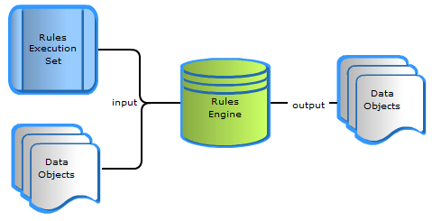
What is a rule engine ?

Slide 49
Advantages of Rule Engines
Greater flexibility:
Easier to grasp:
Reduced complexity:
Reusability:

Slide 50

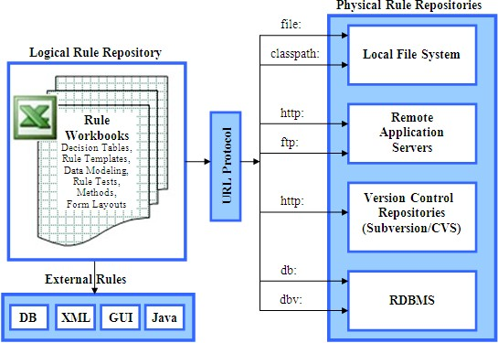
Open source rule engines

Slide 51
What is New and Noteworthy in Drools 6.4.0
DROOLS WORKBENCH
Various UI improvements
New Locales (Locales ru (Russian) and zh_TW (Chineses Traditional) have now been added.)
New Decision Server Management UI
Better Java 8 compatibility
More robust incremental compilation
Improved multi-threading behaviour

Slide 52

Rule
Rule Bean
Constraints for above rule
Object type constraint - Applicant Object Type.
Field constraints - age < 18
An object type constraint plus its zero or more field constraints is referred to as a pattern.
The process of matching patterns against the inserted data is, referred to as pattern matching.
rule "Is of valid age" when $a : Applicant( age < 18 ) ← Constraints then $a.setValid( false ); ← Action end
public class Applicant { private String name; private int age; private boolean valid; //getter and setter methods here }

Slide 53
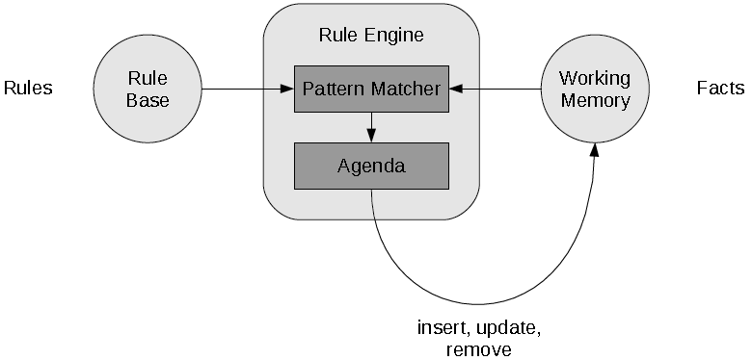
Rule Engine introduction & Working
The rule engine is the computer program that delivers Knowledge Representation and Reasoning(KRR) functionality to the developer. At a high level it has three components:
Ontology (“Things” e.g java Classes/Beans )
Rules
Data

Slide 54
Why use a Rule Engine?
Separates application from dynamic logic
Rules can be modified by different groups
No need to recompile or redeploy
All rules are in one place
Declarative Programming
– Readable and Anyone can easily modify rules.
Centralization of Knowledge
- Repository of business policy
Speed and Scalability
- Rete algorithm, Leaps algorithm

Slide 55
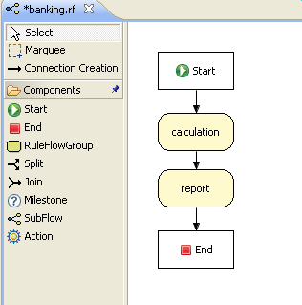
Rule Flow

Slide 56
Drools Expert & Drools Rule Format
Drools has an enhanced and optimized implementation of the Rete algorithm for object oriented systems called as ReteOO.
Drools Expert is a declarative, rule based, coding environment.
Drools Rule Formats
Drools Rule Language (DRL)
Domain-specific language (DSL)
Decision tables
Guided rule editor
XML

Slide 57
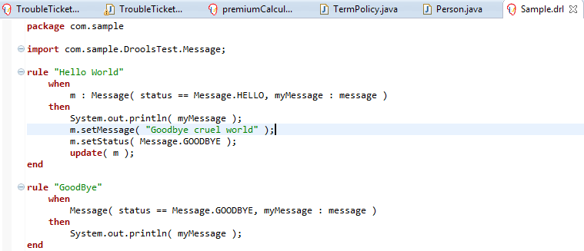
Drools Rule Language(DRL)

Slide 58
Domain-specific language (DSL)
DSL are written in natural language statements.
Domain experts (such as business analysts) can validate and do changes as per requirements.
DSL definitions consists of transformations from DSL "sentences" to DRL constructs.
DRL
DSL
DSLR
DRL & DSL mapping
Cheese(age < 5, price == 20, type=="stilton", country=="ch")
[when]There is a Cheese with=Cheese() [when]- age is less than {age}=age<{age} [when]- type is '{type}'=type=='{type}‘ [when]- country equal to '{country}'=country=='{country}'
There is a Cheese with - age is less than 42 - type is 'stilton'
[when]Something is {colour}=Something(colour=="{colour}")

Slide 59
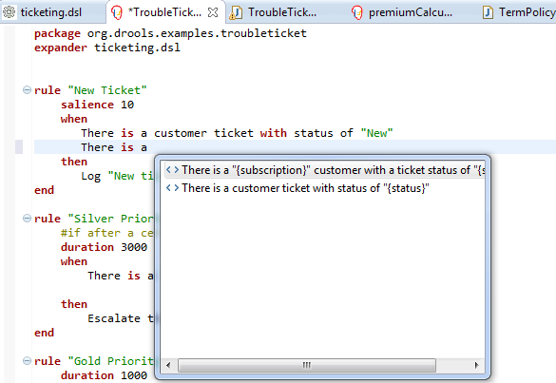
Domain-specific language (DSL)

Slide 60
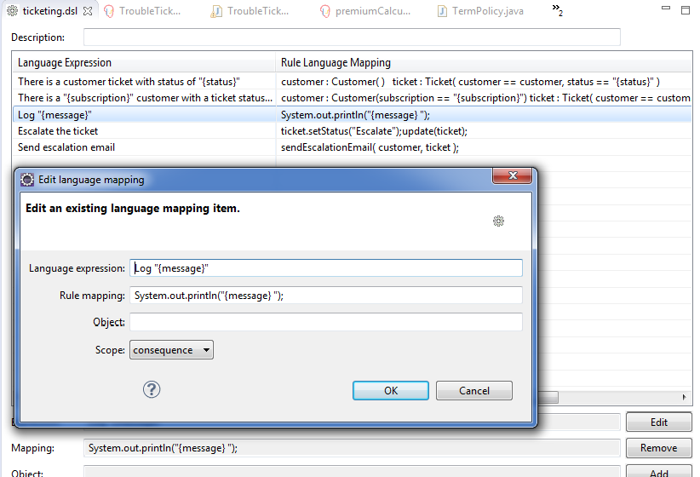
Domain-specific language (DSLR)

Slide 61
Decision table
Decision tables are a "precise yet compact" (ref. Wikipedia) way of representing conditional logic, and are well suited to business level rules.
spreadsheet format (XLS), and CSV.
Decision tables are not recommended for rules that do not follow a set of templates, or where there are a small number of rules
Each row in spreadsheet is a rule
Decision tables are essentially a tool to generate DRL rules automatically

Slide 62
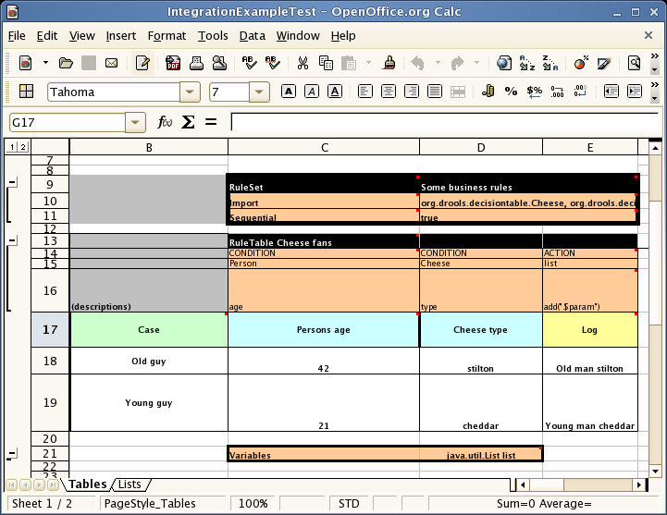
Decision tables

Slide 63
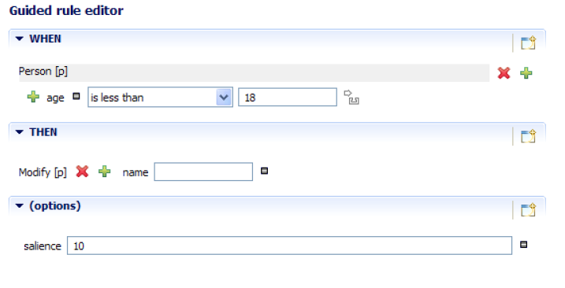
Guided Rule Editor

Slide 64
XML Rule Language

Slide 65
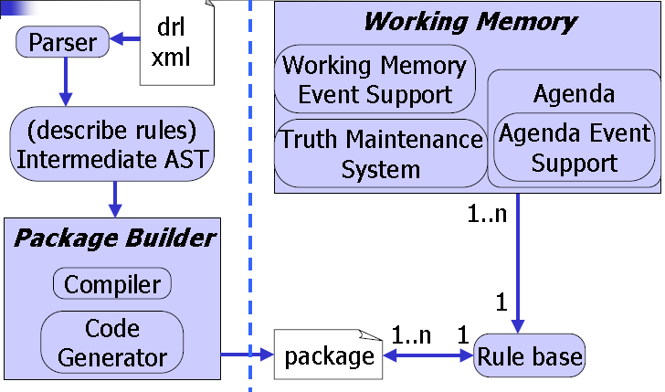
Drools Rule Language :Executing Rules

Slide 66
Drools Rule Language :Executing Rules
A Knowledge Base is what we call our collection of compiled definitions, such as rules and processes, which are compiled using the KnowledgeBuilder.
First, we will create Knowledge Builder
Add DRL file to Knowledge Builder , it parses and compiles DRL files
If there are no errors, we can add the resulting packages to our Knowledge Base
KnowledgeBuilder knowledgeBuilder = KnowledgeBuilderFactory.newKnowledgeBuilder();
knowledgeBuilder.add(drlFileAsResource, ResourceType.DRL);
Collection pkgs = knowledgeBuilder.getKnowledgePackages();
knowledgeBase = KnowledgeBaseFactory.newKnowledgeBase();
knowledgeBase.addKnowledgePackages(pkgs);

Slide 67
Drools Rule Language :Executing Rules
KnowledgeSession provides the way of exposing objects to be ruled.
Stateless Knowledge Session
Stateful Knowledge Session
StatelessKnowledgeSession ksession = kbase.newStatelessKnowledgeSession();
Applicant applicant = new Applicant( “Rajesh Kumar", 16 );
ksession.execute( applicant );
assertFalse( applicant.isValid() );
StatelessKnowledgeSession ksession = kbase.newStatelessKnowledgeSession();
Applicant applicant = new Applicant( “Rajesh Kumar", 16 );
knowledgeSession.insert(applicant);
knowledgeSession.fireAllRules();

Slide 68
Drools Rule Language
Knowledge base can be updated inside rule’s body
insert()
Inserted object will be used by rules engines inside current session
update()
Updates existing in working memory object for the rest of rules
delete()
Removed object will not be ruled on current execution

Slide 69
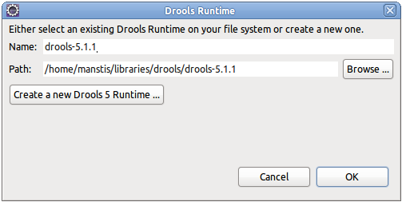
Drools Eclipse IDE
The Eclipse based IDE provides users with an environment to edit and test rules in various formats, and integrate it deeply with their applications.
Required plugins
GEF plugin , GEF is the Eclipse Graphical Editing Framework.
http://download.eclipse.org/tools/gef/updates/releases/
Drools Eclipse IDE plugin
http://download.jboss.org/drools/release/5.4.0.Final/org.drools.updatesite/
Defining a Drools Runtime
Go to windows preferences
under the Drools category,
select "Installed Drools runtimes“
use the default jar files as included in
the Drools Eclipse plugin
by clicking "Create a new Drools 5 runtime"

Slide 70
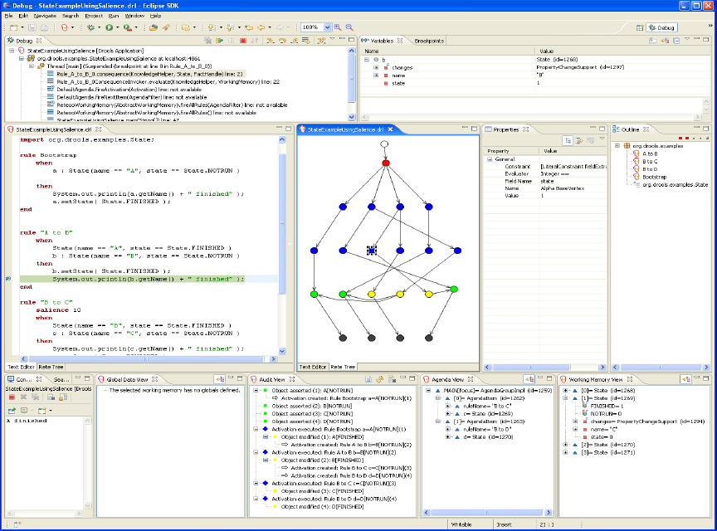

Slide 71
Drools Guvnor Overview
Web-based rule management, storage, editing and deployment environment.
Rule editing
text, guided, decision tables, etc.
Version control
Categorization
Build and deploy
Scenarios

Slide 72
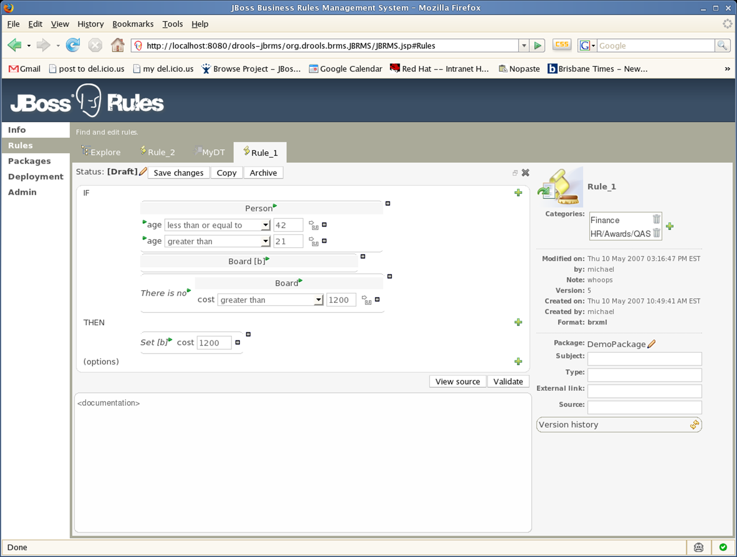
Guvnor Rule Editing

Slide 73
Guvnor Rule Deployment

Slide 74
Guvnor Test Scenarios

Slide 75
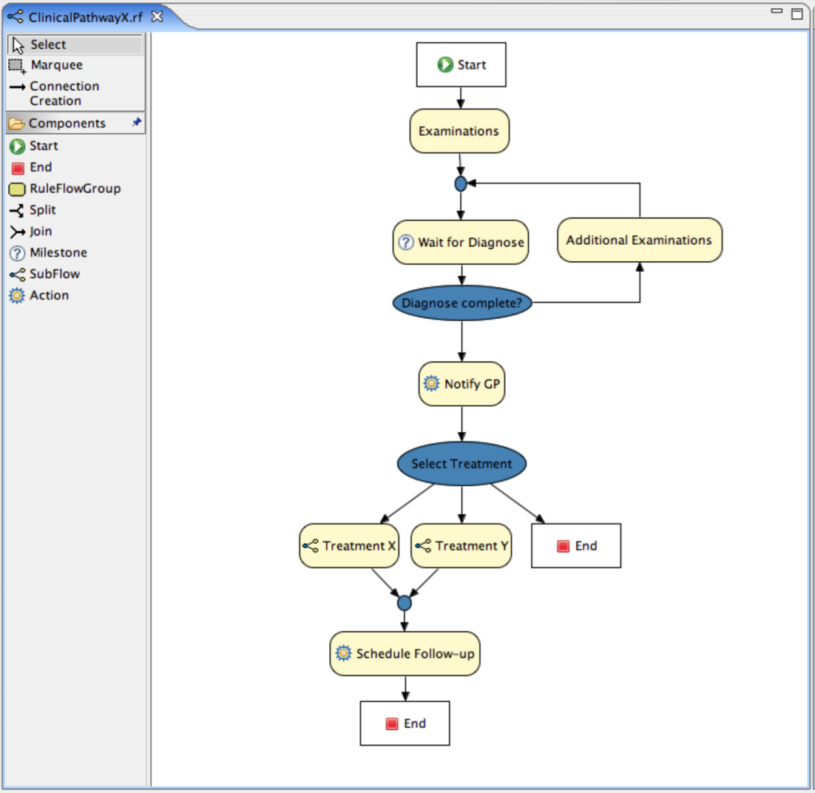
Drools Flow Overview

Slide 76
KIE - Knowledge Is Everything

Slide 77
KIE - Knowledge Is Everything

Slide 78
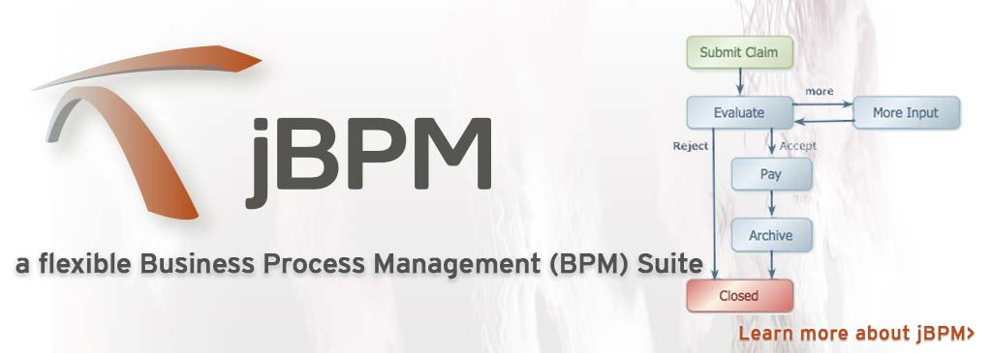
jBPM

Slide 79
jBPM
jBPM (Java Business Process Model) is an open-source workflow engine written in Java that can execute business processes described in BPMN 2.0

Slide 80
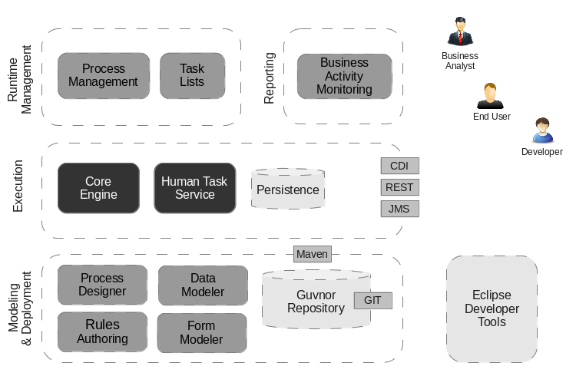
jBPM

Slide 81
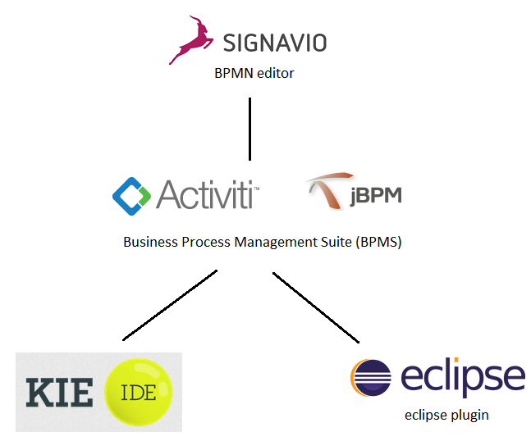
BPM TOOLS

Slide 82
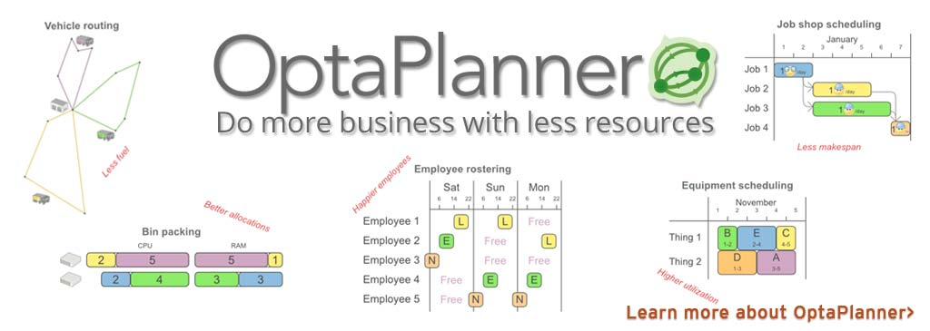
Opta Planner

Slide 83

UberFire

Slide 84
Drools
Drools is a business rule management system (BRMS) with a forward and backward chaining inference based rules engine, more correctly known as a production rule system, using an enhanced implementation of the Rete algorithm.

Slide 85
Drools
Drools is a Business Rules Management System (BRMS) solution. It provides a core Business Rules Engine (BRE), a web authoring and rules management application (Drools Workbench) and an Eclipse IDE plugin for core development.

Slide 86



Drools
Drools Workbench (web UI for authoring and management)
Drools Expert (business rules engine)
Drools Fusion (complex event processing features)

Slide 87
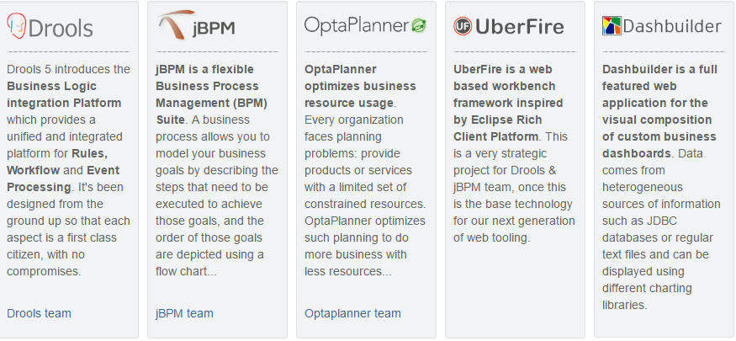
KIE GROUP

Slide 88
Drools Expert

Slide 89
The Business Process Management (BPM) discipline

Slide 92
jBPM
jBPM is a flexible Business Process Management (BPM) Suite.
It is light-weight, fully open-source (distributed under Apache license) and written in Java.
It allows you to model, execute, and monitor business processes throughout their life cycle.

Slide 93
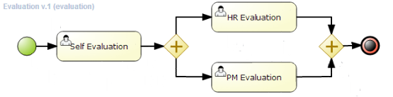
jBPM Graphical Representation

Slide 94
jBPM
A business process to model your business goals by describing the steps that need to be executed to achieve those goals.
The order of those goals are depicted using a flow chart.
This process greatly improves the visibility and agility of your business logic.
jBPM focuses on executable business processes, which are business processes that contain enough detail so they can actually be executed on a BPM engine.

Slide 95
jBPM
The core of jBPM is a light-weight, extensible workflow engine written in pure Java.
It allows you to execute business processes using the latest BPMN 2.0 specification.
It can run in any Java environment, embedded in your application or as a service.

Slide 96
jBPM
BPM creates the bridge between business analysts, developers and end users.
It offers process management features and tools in a way that both business users and developers like.
Complex business logic can be modeled as a combination of business processes with business rules and complex event processing.

Slide 97
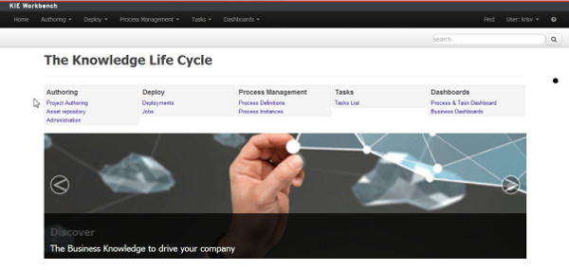

Slide 98
Complete BPM life cycle
Modeling and deployment - author your processes, rules, data models, forms and other assets
Execution - execute processes, tasks, rules and events on the core runtime engine
Runtime Management - work on assigned task, manage process instances, etc
Reporting - keep track of the execution using Business Activity Monitoring capabilities

Slide 100
Resource Types
• DRL: Drools Rule Language
• XDRL: XML Drools Rule Language
• DSL: Domain-specific Language Mapping
• DSLR: Rules using Domain-specific Languages
• DRF: Drools Flow (Proprietary Flow Language, not maintained)
• BPMN2: Business Process using the BPMN2 Standard
• DTABLE: Decision Table
• PKG: Compiled Package

Slide 101
Resource Types
• BRL: Drools Business Rule File
• CHANGE_SET: Bundle of Resources to load based on an XML file
• PMML: Predictive Model Markup Language (Experimental Support)

Slide 102

jBPM 6 Components

Slide 103
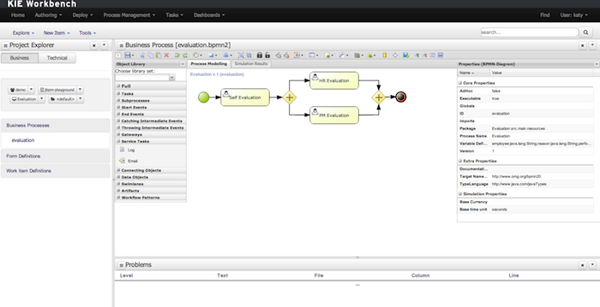
Process Designer

Slide 104
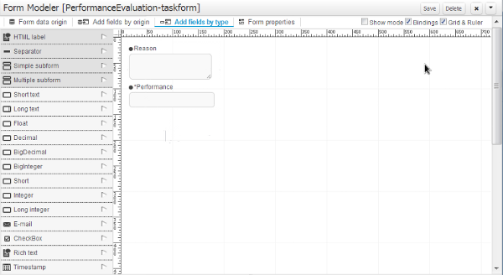

Slide 105
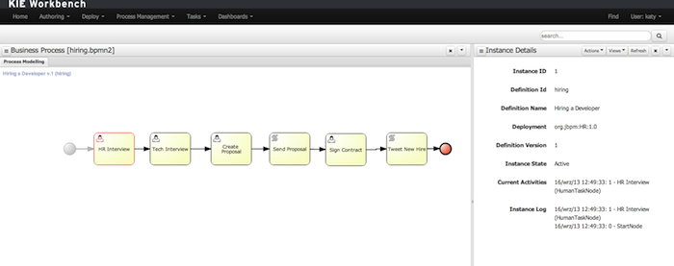
Process Instance and Task Management

Slide 106
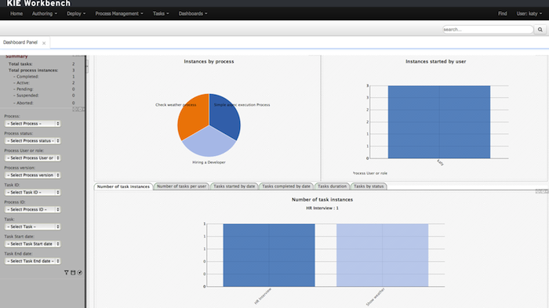
Business Activity Monitoring

Slide 107
Drools

Slide 108
Knowledge-centric APIs
• Knowledge Builder
• Knowledge Base
• Knowledge Session

Slide 109
KIE - Knowledge Is Everything

Slide 110
Stateless Knowledge Session
A stateless session can be called like a function passing it some data and then receiving some results back.
Validation
Is this person eligible for a mortgage?
Calculation
Compute a mortgage premium.
Routing and Filtering
Filter incoming messages, such as emails, into folders.
Send incoming messages to a destination.

Slide 111
Stateful Knowledge Session
Stateful Sessions are long lived and allow iterative changes over time. Some common use cases for Stateful Sessions are, but not limited to:
Monitoring
Stock market monitoring and analysis for semi-automatic buying.
Diagnostics
Fault finding, medical diagnostics
Logistics
Parcel tracking and delivery provisioning
Compliance
Validation of legality for market trades.

Slide 112
Using BPMN 2.0 to Model Business Scenarios
The BPMN 2.0 standard specification was formally released in January 2011.
This specification is the result of collaboration between companies such as Oracle, IBM,
Red Hat, Intalio, and many others within the Object Management Group, to conform
a unified language to model and execute business processes.

Slide 113
Using BPMN 2.0 to Model Business Scenarios
The specification aims to reduce/eliminate the gap between technical business
process representations and the fact that a lot of business analysts use flow
chart representations to define how a company works.
This gap can be eliminated using a standardized mapping between the visual notation of the business process and the execution semantic of the model.
A business processes modeled using the BPMN notation defines the flow of data (messages) and the association of the data artifacts to business activities.

Slide 114
Using BPMN 2.0 to Model Business Scenarios
• Process Modeling
• Process Execution
• Collaboration Modeling
• Choreography Modeling

Slide 116
BPMN elements
• Flow objects
• Connecting objects
• Data
• Grouping
• Artifacts

Slide 117
Flow Objects
Events
Activities
Gateways

Slide 118
Events
• Start events
• Intermediate events
• End events

Slide 122
Activities
Activities define a piece of work that is being done within a company.
We can define atomic and non-atomic activities.
Specification defines three types of activities:
subprocesses
tasks
and call activities

Slide 123
Generic Activity
Call Activity

Slide 124
Gateways
Parallel gateway
Exclusive gateway
Inclusive gateway
Complex gateway.

Slide 130
Connecting objects
Unconditional Sequence Flow
Conditional Sequence Flow
The default sequence flow will be used in Exclusive/Inclusive/Complex gateways

Slide 131
Data
• Data inputs & Data outputs
• Data objects
• Data stores
• Properties (no visual representation)
Data Associations

Slide 133
Task types
• Abstract task
• Service task
• User task
• Business rule task
• Script task

Slide 142
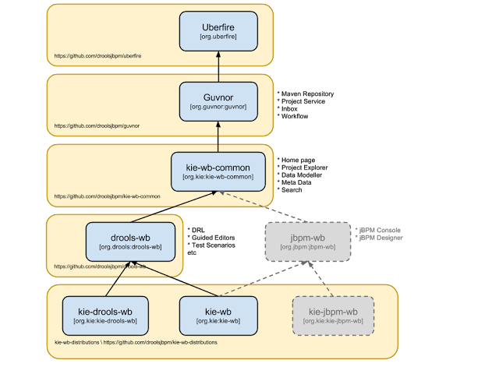
KIE - Knowledge Is Everything

Slide 143
KIE Drools Workbench
Drools Editors, for rules and supporting assets.
jBPM Designer, for Rule Flow and supporting assets.

Slide 144
KIE Workbench
Drools Editors, for rules and supporting assets.
jBPM Designer, for BPMN2 and supporting assets.
jBPM Console, runtime and Human Task support.
jBPM Form Builder.
BAM.

Slide 145
Life Cycles
Author
Authoring of knowledge using a UI metaphor, such as: DRL, BPMN2, decision table, class models.
Build
Builds the authored knowledge into deployable units.
For KIE this unit is a JAR.

Slide 146
Life Cycles
Test
Test KIE knowedge before it's deployed to the application.
Deploy
Deploys the unit to a location where applications may utilize (consume) them.
KIE uses Maven style repository.

Slide 147
Life Cycles
Utilize
The loading of a JAR to provide a KIE session (KieSession), for which the application can interact with.
KIE exposes the JAR at runtime via a KIE container (KieContainer).
KieSessions, for the runtime's to interact with, are created from the KieContainer.
Run
System interaction with the KieSession, via API.

Slide 148
Life Cycles
Work
User interaction with the KieSession, via command line or UI.
Manage
Manage any KieSession or KieContainer.

Slide 149
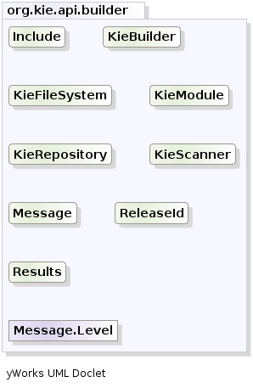
KIE

Slide 150
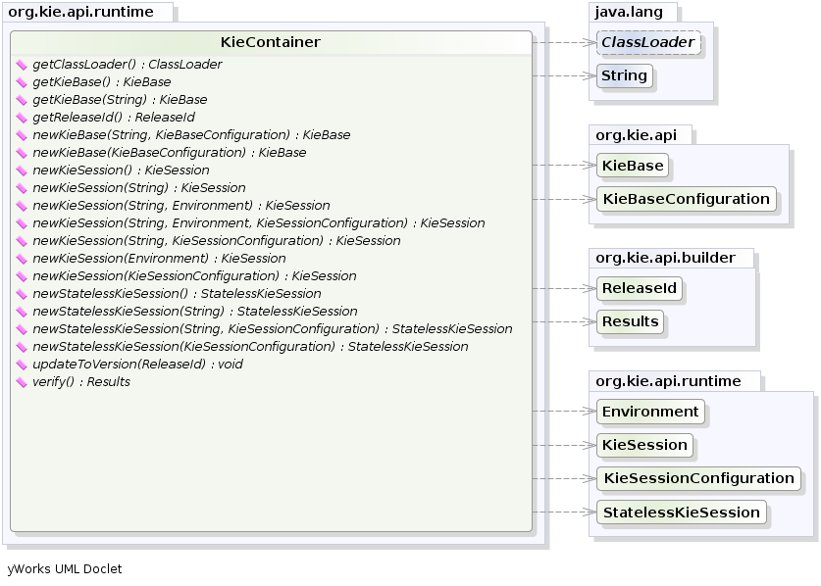
KIE

Slide 151
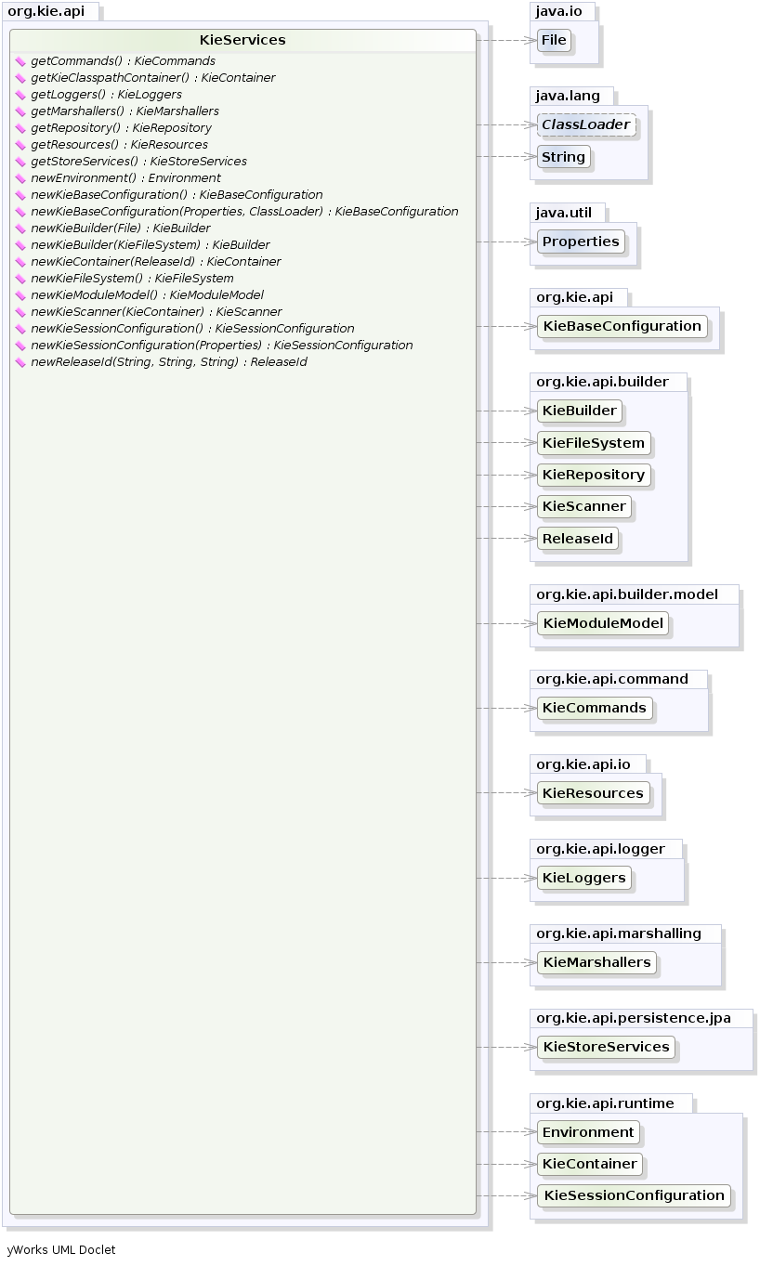

Slide 152
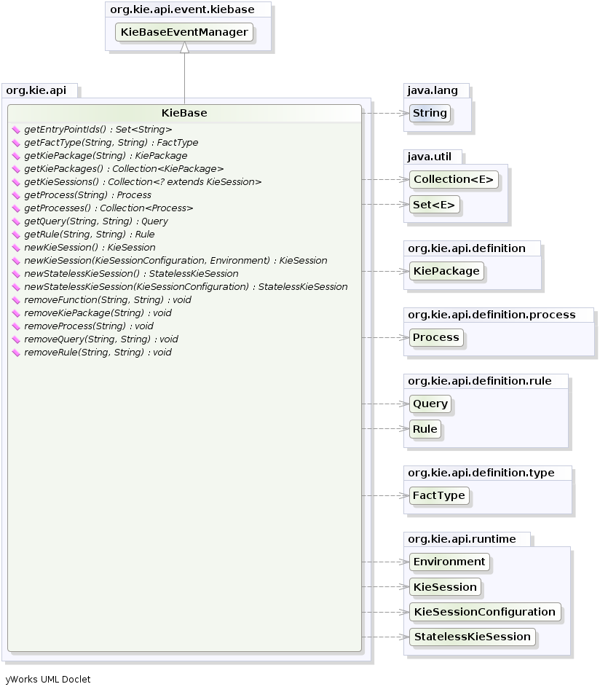

Slide 153
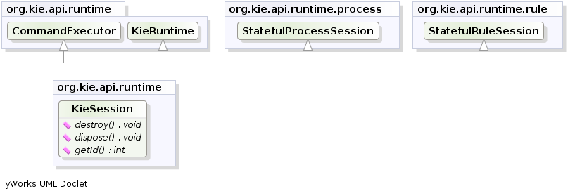
KIE Session

Slide 154
Drools Runtime and Language
Artificial Intelligence
Thinking Machines Corporation was one of the leading AI firms in 1990, it had sales of nearly $65 million. Here is a quote from its brochure:
“Some day we will build a thinking machine. It will be a truly intelligent machine. One that can see and hear and speak. A machine that will be proud of us.”
Computer vision, neural networks, machine learning and knowledge representation and reasoning (KRR) have made great strides towards becoming practical in commercial environments.

Slide 155
Knowledge Representation and Reasoning
KRR is about how we represent our knowledge in symbolic form, i.e. how we describe something.
Reasoning is the act of thinking using this knowledge.
System based object-oriented languages, like C++, Java and C#, have data definitions called classes for describing the composition and behaviour of modeled entities.
Object classification systems are limited to ensure computational efficiency.
KRR is often referred to as the core of Artificial Intelligence.

Slide 156
Production Rule System

Slide 157
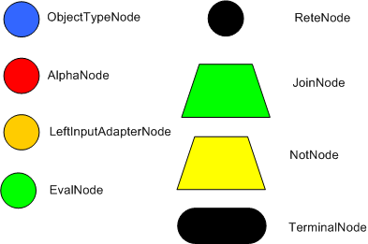
ReteOO
Rete algorithm was invented by Dr. Charles Forgy.
Rete algorithm can be broken into 2 parts: rule compilation and runtime execution.
Rule base is compiled into discrimination network.
Discrimination network is used to filter data as it propagates through the network.

Slide 158
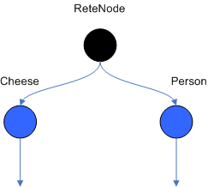
Object Type Nodes

Slide 159
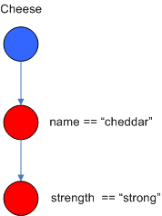
Alpha Nodes

Slide 160
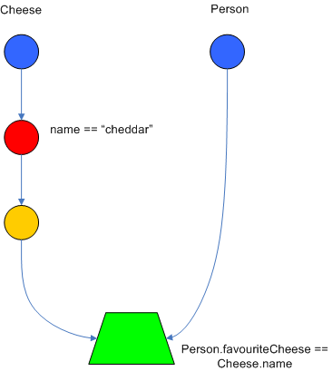
JoinNode

Slide 161
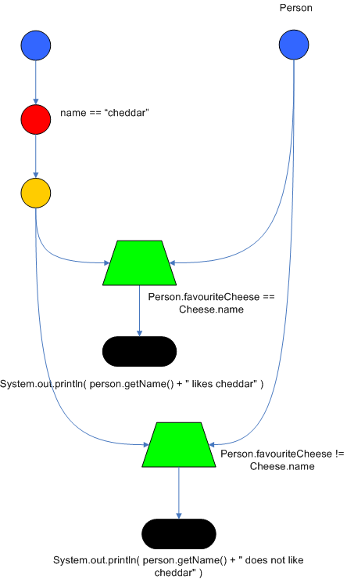
Node Sharing

Slide 162

Rete Algorithm example
rule 1
when
Cheese( $cheddar : name == "cheddar" )
$person : Person( favouriteCheese == $cheddar )
then
System.out.println( $person.getName() + " likes cheddar" );
end
rule 2
when
Cheese( $cheddar : name == "cheddar" )
$person : Person( favouriteCheese != $cheddar )
then
System.out.println( $person.getName() + " not likes cheddar" );
end

Slide 163
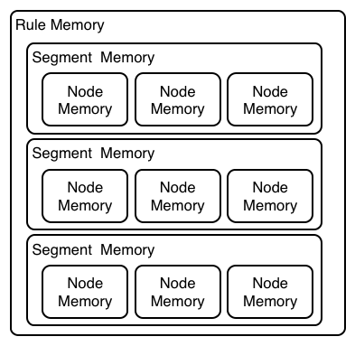
PHREAK Algorithm (Drool 6)

Slide 164
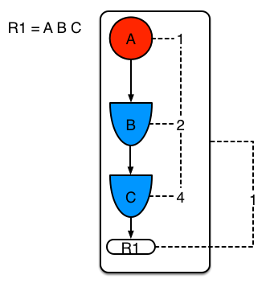
Single Rule No Sharing

Slide 165
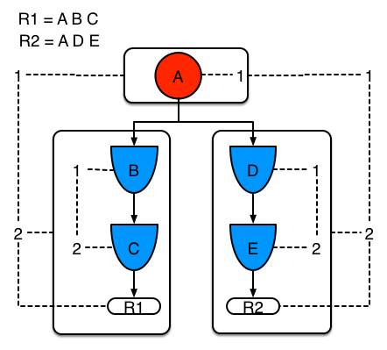
Two rules, with sharing

Slide 166

Three rules, with sharing

Slide 167

Single rule, with sub-network and no sharing

Slide 168

Two rules, one with a sub-network and sharing

Slide 169
Drools Vision
Drools was born as a rule engine, but following the vision of
becoming a single platform for business modelling, it realized
it could achieve this goal only by leveraging 3 complementary

Slide 170
Drools 6 – Business Logic Integration Platform

